Slide 1
Unit – I ( Introduction to Compiler)
BSc CSIT 5th Semester
2020
Mid-Western University, Surkhet
Prepared By:
Dabbal Singh Mahara

Slide 2
Why to take this course
To understand compilers and languages
To understand code structure
To understand language semantics
To understand relationship between source code and generated machine code
To become a better programmer
Nice balance between theory and practice
Theory: Mathematical models: regular expression, automata, grammars, graphs and algorithms that use these models,
Practice: Apply theoretical notions to build a real compiler
Programming experience:
You will write a large program which manipulates complex data structures and learn more about c++ and Intel x86 and translate one language into another representation
Typical compilers: VC, VC++, GCC, javac, Fortran, Pascal , VB
Typical translators: word to pdf, pdf to postscript

Slide 3
Introduction
Programming languages are notations for describing computations to people and to machines.
The world depends on programming languages, because all the software running on all the computers was written in some programming language.
But, before a program can be run, it first must be translated into a form in which it can be executed by a computer. The software systems that do this translation are called compilers.
This course is about how to design and implement compilers.
The principles and techniques for compiler design are applicable to so many other domains that they are likely to be reused many times in the career of a computer scientist.
The study of compiler writing touches upon programming languages, machine architecture, language theory, algorithms, and software engineering.
Compilers are not particularly difficult programs to understand once we're familiar with the structure of a compiler in a general sort of way.
The main problem is not that any one part of a compiler is hard to understand; but, rather, that there are so many parts and we need to have absorbed most of these parts before any of them make sense.

Slide 4
Language Processing system
The process of creating an executable image from a source-code file can involve several stages other than compilation (preprocessing, assembly, linking, and so forth). That is, several other programs may be required to create an executable target program.
Pre-Processor:
A pre-processor is considered as a part of compiler, is a tool that produces input for compilers.
Preprocessors typically do macro substitutions, strip comments from the source code, and handle various housekeeping tasks with which you don't want to burden the compiler proper.
Compiler:
A compiler is a program that reads the whole source code at once, creates tokens, checks semantics, generates intermediate code, executes the whole program and may involve many passes.
In contrast, an interpreter reads a statement from the input, converts it to an intermediate code, executes it, then takes the next statement in sequence.
If an error occurs, an interpreter stops execution and reports it, whereas a compiler reads the whole program even if it encounters several errors.

Slide 5
Language Processing system
Assembler:
An assembler translates assembly language programs into machine code.
The output of an assembler is called an object file, which contains a combination of machine instructions as well as the data required to place these instructions in memory.
Linker:
Linker is a computer program that links and merges various object files together in order to make an executable file.
All these files might have been compiled by separate assemblers.
The major task of a linker is to search and locate referenced module/routines in a program and to determine the memory location where these codes will be loaded, making the program instruction to have absolute references.
Loader:
A loader is a part of operating system and is responsible for loading executable files into memory and executing them.
It calculates the size of a program (Instructions and data) and creates a memory space for it.
It initializes various registers to initiate execution.

Slide 6
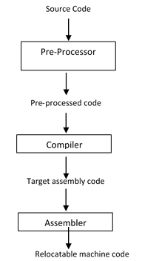
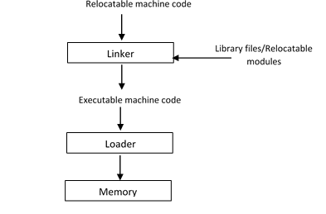
Language Processing system

Slide 7
Language Processors
What is compiler?
Simply stated, a compiler is a program that can read a program in one language- source language, and translate it into an equivalent program in another language – target language.
An important role of the compiler is to report any errors in the source program that it detects during the translation process.
If the target program is an executable machine program, it can then be called by user to process inputs and produce outputs.
Compiler
source program
target program
Target Program
Input
output

Slide 8
Interpreter
This is also common kind of language processor.
Instead of producing a target program as a translation, an interpreter appears to directly execute operations specified in the source program on inputs supplied by the user.
The machine language target program produced by a compiler is usually much faster than an interpreter at mapping inputs to outputs.
An interpreter, however, can give better error diagnostics than a compiler because it executes instructions one by one.
source program
Interpreter
Input
output

Slide 9
Java Language Processor
combines compilation and interpretation.
Java source program first is compiled into an intermediate form called bytecodes.
The bytecodes are then interpreted by a virtual machine.
This arrangement provides platform independence to java language because the bytecodes are portable and can be executed on any platform by its java virtual machine.
In order to achieve faster processing of inputs to outputs, some java compilers translate byte codes to machine codes immediately before they run the intermediate program to process input. These types of compilers are called just-in-time compilers.
source program
Java Compiler
bytecodes
JVM
Input
output

Slide 10
Two-Pass Model of a Compiler
Source Code
Front End
IR
Back End
Machine Code
Errors
The front end receives high level source program as input and produces the intermediate representation.
The front end maps legal source code to IR.
The front end is also called analysis part.
The back end generates the target machine code from the IR of source program.
The back end is also called synthesis part.
The front end/back end model provides high flexibility of constructing different compilers by attaching either front end or back ends to each other.

Slide 11
Front End
Recognizes legal and illegal programs
Reports errors in an useful way
Produces IR and preliminary storage map
Source Code
Scanner
Tokens
Parser
IR
Errors

Slide 12
Scanner
maps character streams into words which are the basic unit of syntax
produces a pairs
a word and
its part of speech
Example: x = x + y
<id, x>
<assign, =>
<id, x>
<addop, +>
<id, y>
We call <token type , word> a token.
typical tokens: number, identifier, +, -, new, while, if, ;,{, (, <, comments
<id, x>
token type
word

Slide 13
Parser
Recognizes context free syntax and reports errors
Guides context-sensitive (semantic ) analysis
Builds IR for source program
Context-syntax is specified with a grammar G = ( S, N, T, P)
Where S is start symbol
N is the set of non-terminal symbols
T is a set terminal symbols or words
P is a set of productions or rewrite rules
Example: a grammar for expressions
S -> E
E -> E OP T
| T
T -> num
| id
OP -> +
| -
For this CFG
S = S
N = { N, E, OP, T }
T = { num, id, + , - }
P = { 1, 2, 3, 4, 5, 6, 7 }

Slide 14
Parser
Parse the sentence : x + 2 – y
Derivation:
S -> E OP T
-> E OP y
-> E - y
-> E OP T – y
-> E OP 2 – y
-> E + 2 – y
-> T + 2 – y
-> x + 2 - y
To recognize a valid sentence in some CFG, we reverse this process and build up a parse

Slide 15
Back End
It provides flexibility to construct compilers for different languages.
It doesn’t matter what language we programming, as long as the compiler’s front end generates IR representation that can go into back end.
Translates the IR into target machine code
Choose machine (assembly) instructions to implement each IR operation
Ensure conformance with the system interfaces
Decides which values to keep in registers
IR
Instruction Selection
IR
Register Allocation
IR
Instruction Scheduling
Machine Code
Errors

Slide 16
Instruction Selection
Performance of computer system is determined not its raw speed but also by how well compilers can exploit its features.
Thus, in modern computer architecture development, compilers are developed in the processor design stage, and compiled code running on simulators, is used to evaluate the proposed architectural features.
One of the best known examples of how compilers influenced the deign of computer architecture was the invention of RISC architecture.
The nature of instruction set of the target machine has a strong effect on the difficulty of instruction selection.
If we do not care about efficiency of the target program, instruction selection is straight forward.
To produce fast and compact code. That is, code to be efficient in time and consume less memory, instruction selection is very important.
Take advantages of target features such as addressing modes
Usually viewed as pattern matching problem – Dynamic programming

Slide 17
Register Allocation
Almost all high performance systems take advantages of memory hierarchies.
Memory hierarchies are the response to basic limitation that we can build very fast storage or very large storage, but not storage that is both fast and large.
Memory hierarchy consists of several levels of storage with different speeds and sizes, with the level closest to the processor being the fastest but smallest.
The average memory-access time of a program is reduced if most of its accesses are satisfied by the faster levels of the hierarchy.
Registers are memory locations inside CPU itself. These memory units are run by the same CPU clock. So, work in same speed as CPU.
Using registers effectively is probably the single most important problem in optimizing a program.
To make target run faster, better to have each operand in a register when it is used, to avoid memory loads and store, which are many order slow in speed than registers.
Registers are in limited number, so manage these limited set of resources- register file
Register allocation can change instruction choices and reduce LOADs and STOREs with memory.
Optimal register allocation is NP-Complete.

Slide 18
Instruction Scheduling
The rapid evolution of computer architecture has led to an insatiable demand for new compiler technology.
Almost all high performance systems take advantages of two basic techniques: parallelism and memory hierarchies.
Parallelism can be found at several levels: instruction level, where multiple operations are executed simultaneously and processor level, where different threads of same application run on different processors.
Compiler can rearrange the instructions to make instruction-level parallelism more effective.
Parallel code can be automatically generated by a compiler from conventional sequential program. Such a compiler hides details of finding parallelism in a program, distributing the computation across the machine, and minimizing synchronization and communication among the processors.
Instruction scheduling avoids hardware stall and interlock and helps to use all functional units productively.
Optimal scheduling NP-Complete nearly in all cases

Slide 19
Three Pass Compiler
This adds one more stage between front and back ends for code optimization.
This takes IR produced by front end, analyzes the IR and rewrites (or transforms ) the IR.
The primary goal is to reduce the running time of the compiled code.
It may improve space usage, even power consumption.
It must preserve the meaning of the source code.
source program
Front End
IR
Middle End
IR
Back End
Machine Code
Errors

Slide 20
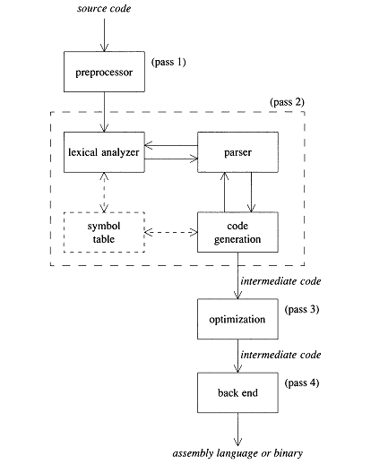
A typical four - pass compiler

Slide 21
A typical four - pass compiler
The structure of a typical four-pass compiler is shown in above Fig.
The preprocessor is the first pass. Preprocessors typically do macro substitutions, strip comments from the source code, and handle various housekeeping tasks with which you don't want to burden the compiler proper.
The second pass is the heart of the compiler. It is made up of a lexical analyzer, parser, and code generator, and it translates the source code into an intermediate language that is much like assembly language.
The third pass is the optimizer, which improves the quality of the generated intermediate code.
And the fourth pass, the back end, translates the optimized code to real assembly language or some form of binary, executable code. Of course, there are many variations to this structure.
Many compilers don't have preprocessors; others generate assembly language in the second pass, optimize the assembly language directly, and don't have a fourth pass; still others generate binary instructions directly, without going through an ASCII intermediate language like assembler.

Slide 22
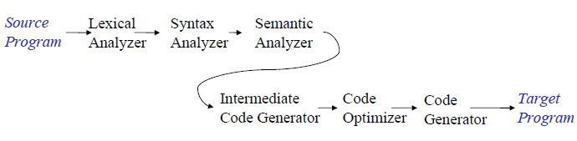
Phases of Compiler
A phase is an independent task used in the compilation process.
Typically, several phases are combined into a single pass.
In general, phases of a compiler are:
Lexical Analyzer
Syntax Analyzer
Semantic Analyzer
Intermediate Code Generator
Code Optimizer
Target Code Generator
First four phases are called analysis part or front end of compiler and last two phases are called synthesis part or back end of the compiler.

Slide 23
Lexical Analyzer
The lexical analyzer phase of a compiler (often called a scanner or tokenizer ) translates the input into a collection of basic language elements called tokens.
That is, a token is an indivisible lexical unit.
In C, keywords like while or for are tokens (we can't say wh ile), symbols like >,>=, >>, and ( are tokens, names and numbers are tokens, and so forth.
The original string that comprises the token is called a lexeme.
Note that there is not a one-to-one relationship between lexemes and tokens. A name or number token, for example, can have many possible lexemes associated with it; a while token always matches a single lexeme.
In general, a lexical analyzer recognizes the token that matches the longest lexeme for example, < and <= , in this case less than equal , rather than less than and equal separately.

Slide 24
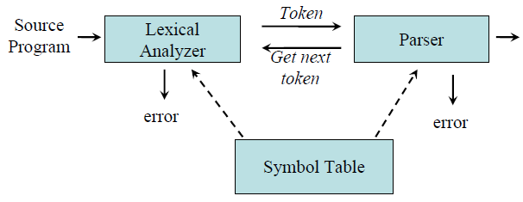
Lexical Analyzer
The lexical analyzer is typically a self-contained unit that interfaces with the rest of the compiler via a small number of subroutines and global variables.
The parser calls the lexical-analyzer every time it needs a new token, and the analyzer returns that token and the associated lexeme.
Since the actual input mechanism is hidden from the parser, you can modify or replace the lexical analyzer without affecting the rest of the compiler.
Lexical analyzer may also perform other auxiliary operation like removing redundant white space, removing token separator (like semicolon) etc.

Slide 25
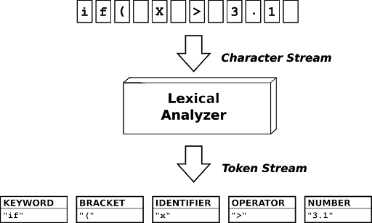
Lexical Analyzer

Slide 26
Syntax Analyzer
Syntax analyzer is also called the parser.
A parser is a group of subroutines that converts a token stream into a parse tree, and a parse tree is a structural representation of the sentence being parsed.
The syntax of a language is specified by a context free grammar (CFG).
The rules in a CFG are mostly recursive.
A syntax analyzer checks whether a given program satisfies the rules implied by a CFG or not.
If it satisfies, the syntax analyzer creates a parse tree for the given program.

Slide 27
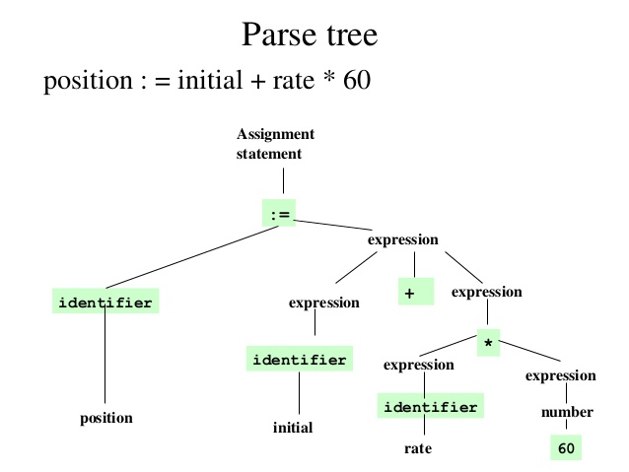

Slide 28
Semantic Analyzer
A semantic analyzer checks the source program for semantic errors and collects the type information for the code generation.
Type-checking is an important part of semantic analyzer where the compiler checks that each operator has matching operands.
It gathers type information and saves it in either the syntax tree or the symbol table, for subsequent use during intermediate-code generation.
For example, many programming language definition require an array index to be an integer; the compiler must report an error if a floating point number is used to index an array.
Similarly, automatic type conversion called coercions may take place in semantic analysis phase. For example, a binary arithmetic operator may be applied to either a pair of integers or a pair of floating point numbers. if the operator is applied to a floating point number and an integer, the compiler may convert or coerce integer to floating point number.
Actually, semantic analysis is not done as a separate phase in compiler, it is done in parallel with the parsing by associating some attributes to grammar symbols and semantic rules with grammar productions.

Slide 29
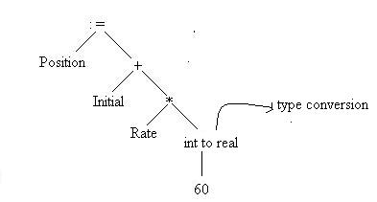
Semantic Analyzer: Example

Slide 30
Intermediate Code Generator
Instead of generating machine language directly, compilers create a program in an intermediate language that is translated by the compiler's back end into actual machine language.
It's somewhat misleading to represent this phase as a separate component from the parser, because most compilers generate code as the parse progresses. That is, the code is generated by the same subroutines that are parsing the input stream.
An intermediate language is often used by many compilers for analyzing and optimizing the source program. The intermediate language should have two important properties:
– It should be simple and easy to produce.
– It should be easy to translate to the target program
There are advantages and disadvantages to an intermediate-language approach to compiler writing.
The main disadvantage is lack of speed. A parser that goes straight from tokens to binary object code will be very fast, since an extra stage to process the intermediate code can often double the compile time.

Slide 31
Intermediate Code Generator
The advantages, however, are usually enough to justify the loss of speed. These are, in a nutshell, optimization and flexibility.
A few optimizations, such as simple constant folding-the evaluation of constant expressions at compile time rather than run time-can be done in the parser. Consequently, parsers for optimizing compilers output an intermediate language that's easy for a second pass to optimize.
Intermediate languages give us flexibility as well.
A single lexical-analyzer/parser front end can be used to generate code for several different machines by providing separate back ends that translate a common intermediate language to a machine-specific assembly language.
Conversely, we can write several front ends that parse several different high-level languages, but which all output the same intermediate language. This way, compilers for several languages can share a single optimizer and back end.

Slide 32
Code Optimizer
Machine independent code-optimization attempts to improve intermediate code so that better target code will result.
Usually better means faster and compact code.
There is a great variation in the amount of code optimization different compilers perform. Those which do the most, called optimizing compilers, spend significant amount of time on this phase.
There are simple optimizations that significantly improve running time of target program without slowing down the compilation too much.
Some of these optimizations are:
Detection of loop invariants
Common sub-expression elimination
Dead code detection and elimination

Slide 33
Target Code Generator
The code generator takes intermediate representation of source program and maps it to the target language.
The target code is normally a relocatable object file containing the machine or assembly codes.
If target language is machine code, registers or memory locations are selected for each of the variable used by the program.
Then intermediate instructions are translated into sequence of machine instructions to perform the same task.
To improve the performance of target code execution on the processor, instruction scheduling is one of the important task performed in code generation phase.
The instruction scheduling finds independent sequences of machine instruction so that ILP or multiprocessing capability of architecture can be utilized.

Slide 34
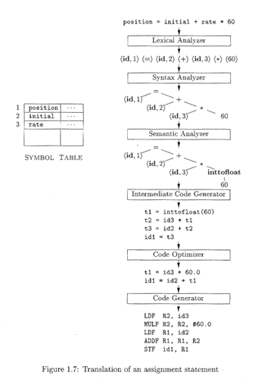
Example: Compilation process for an assignment statement

Slide 35
Symbol Table
Symbol tables are data structures that are used by compilers to hold information about source program constructs such as identifier.
The information is collected incrementally by analysis phases of compiler and used by synthesis phases to generate the target code.
Entries in the symbol table contain information about an identifier such as its character string (lexeme), its type, its position in storage and any other relevant information.
Symbol table needs to support multiple declarations of the same identifier within a program.
The role of symbol table is to pass information from declarations to users.
A semantic action puts information about identifier x into the symbol table, when the declaration of x is analyzed.
A semantic action associated with the production such as factor -> id gets information about the identifier from the symbol table.

Slide 36
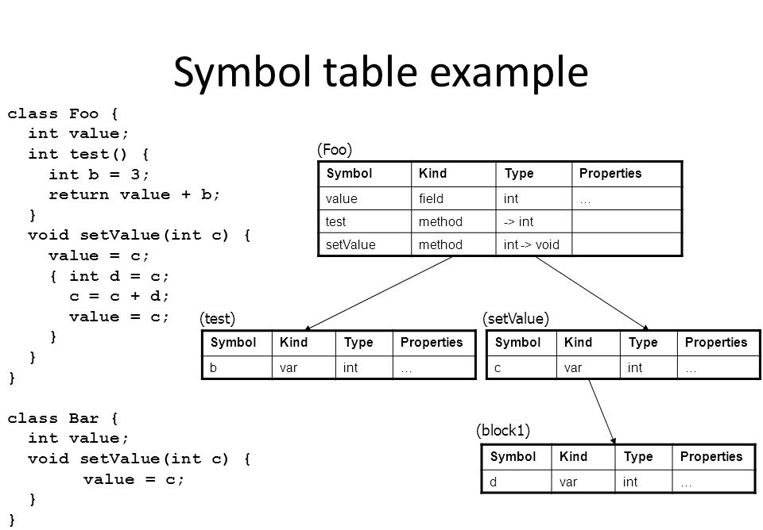

Slide 37
Thank You !

